Slide 1



Readiness for Early Childhood Education
Establishing ECD centres in flood affected communities of Pakistan –
a multi-sectoral experience in emergencies and beyond
Baela Raza Jamil & Huma Sikander
March 12, 2013
Paper presented at 57th CIES Conference through the support of the Education Support Program of the Open Society Foundations.

Slide 2
Presentation Flow
Country Profile
Crafting ECCE Conversations 1990- 2015
Spaces : National , Regional & Global
Conceptual Framework – Breaking Boundaries
Sanjha Vehra – our courtyard – an ECD emergency -development initiative - key elements and current status
Monitoring, Tracking and Research
Challenges & Opportunities

Slide 3
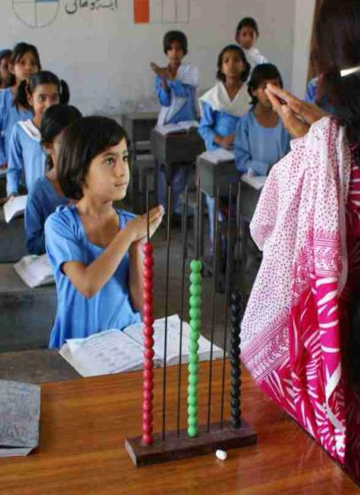
Pakistan – Key Facts
Population 185 + million
Provinces 5 & 3 areas (FATA, ICT & AJK)
Poverty : 22% ++
Maternal Mortality: 87 per 1000
Infant Mortality : 61 per 1000
Education Provision:
Public: 63% Private: 37%
NER Primary: 80%
ECE (3-5 yrs): 50% (rural 37%)
Incl. Private Sector
Article 25- A; Right To Education 2010 for 5-16 years
RTE Laws passed in 2 areas 2012/13
GDP Allocation 1.5-2.0%
Emergencies 2005 -2013 ….

Slide 4
National Policy and Sector Plans For ECE
National Education Policy (NEP) 2009 has ECE conceptualized as
‘broadening the base’ of learning – 0-8 is not a focus currently
NEP 2009 earmarked ECE as a 2 year focus for 3-5 year olds with
commitment for one year of ECE experience in public sector schools
– Of 5 ECE Policy Actions - 3 are about Quality (pp.35-36)
National Plan of Action (NPA) for EFA 2002-2015 – ECE as Third Pillar
after UPE & Literacy (targeting access to 50% children)
After the 18th Amendment in 2010 Education devolved completely to
the provinces – each province committed to NEP 2009-incl. 25 A RTE
Provincial Sector Plans almost in place; all include ECE as a focus
area supported by GPE in 2 provinces; a scaling up strategy 2015++
Balochistan has a Provincial ECE Plan 2011-2015 for 100% coverage
Khyber Pakhtoonkhwa approved 2 year ECE 4-5 yrs in sector plan

Slide 5
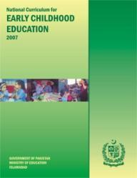
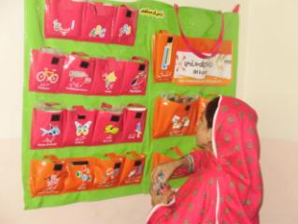
Quality - Excellent National Curriculum & Standards -
ECE National Curriculum 2007 – a comprehensive holistic document developed with best practitioners in the country (upgraded the 2002 document)
Early Learning Development Standards (ELDS) 2009
In 2012 consultations on Learning Metrics for Early Years – 7 Domains
Training modules and learning materials for ECE in all provinces: innovative programs by CSOs, INGOs & donors
Textbooks/materials can be produced by multiple providers through open advertisement - space for innovation

Slide 6
ECCE /ECD Building the Argument/Momentum
1990 –1999 - high stakes for ECCE -Jomtien to MRI/PET scans- brain sciences research
2000- 2010- Dakar to Moscow : Deepening evidence for ECCE; integrating ECCE in policies
2011-onwards: Broadening the scope, ownership; rigor of measurement, across sectors learning goals for ECCE: national, regional and international levels – groups : ARNEC, INEE, GPE, GEFI, LMFT,ASER, SAARC - ECCE as learning transitions

Slide 7

Early Childhood - A lifelong investment for society
Early childhood 0-8 – creating equity for the child families and society – a contested terrain – yet synergistic: nexus of all MDGs - poverty, maternal and child health, education, gender equality, environmental sustainability & partnerships
Children are born ready to learn. They cultivate 85 percent of their intellect, personality and skills by age five. The first months and years of life set the stage for lifelong development.

Slide 8
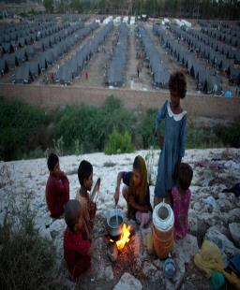

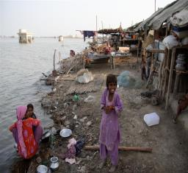
Early Childhood Development & Emergencies
Widespread emergencies in Pakistan since 2005
– Natural disasters, conflicts & displacements – 30 -40 million affected since 2005
ITA works in emergencies only if support
extends beyond emergencies minimum 3 years
ECD (0-5/8) conceived originally in 2009 Swabi camps for the displaced mothers/children during conflict as a multi-sectoral program (pre – primary and post primary)
Aftermath of 2010 floods ECD - ITA designed a comprehensive multi-sectoral community based program informed by ASER 2010 results – (low access/low learning) – catering to 0-5 year olds and their guardians
ECD is done in tandem with school improvement of area govt. schools to support transitions from pre – primary, to primary and post primary levels.

Slide 9
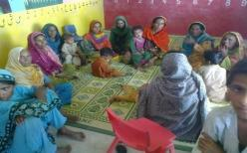
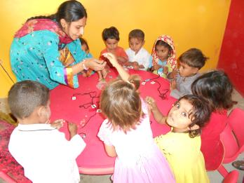
A rigorous bold intervention for affected mothers and children- households
Established 16 centers in 3 flood
affected districts of Punjab & Sindh
(I) Rahim Yar Khan
(ii) Muzaffar Garh
(iii) Shikarpur (Sindh)
Thru community based consultations
Name coined by local community
“Sanjha Verah” (SV) in Seraiki and
“Pahnjo Vehro” (PV) in Sindhi.

Slide 10
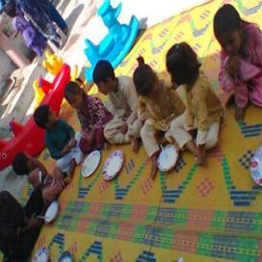
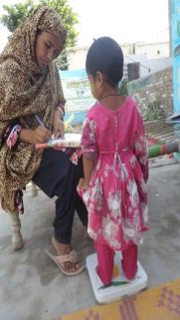
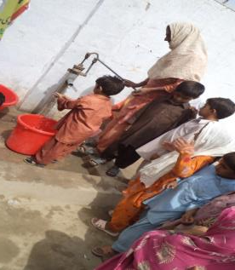
ECD Centres / Sanjha Verah…
“SANJAH/ PANJHO VEHRA/O”(SV/PV) literally translated as
“OUR COURTYARD”
conveys several meanings :
an abode of togetherness , protection and development, ownership, community participation and empowerment;
SV is a holistic
Early Childhood Development approach, for Strong Early Foundations for children and mothers /care givers
0- 5 (contd. In schools up to 8 )

Slide 11
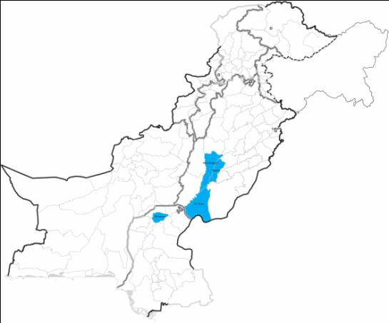
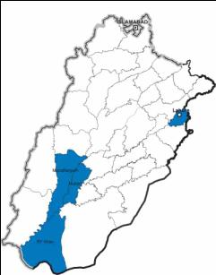
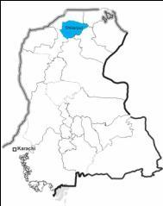
ECD in Provinces & Districts
Punjab
Pakistan
Target Districts
Muzaffargarh
Rahim Yar Khan
Shikarpur
Jalalpur Pirwala
Kot Adu
Zahirpir
Sindh
Shikarpur

Slide 12
Conceptual Framework– Breaking Boundaries
ECD – From Emergencies to Development
Emergencies an Opportunity to expand the policy discourse from ECE to ECCE /ECD an integrated multi-sectoral; multi-partnerships approach –led by civil society – affecting majority of MDGs
Community engagement to rebuild their lives through active citizenship, collective ownership and action for n ECD programs
Children 0-8 a reason to collaborate for All– learn new ways of child rearing ; improved health, nutrition, protection learning
Better chances of child transiting from pre to primary and post primary levels :enrolment/learning and citizenship
Conceptualizing and implementation of 0-8 interventions through active parental engagement evidence and celebration –

Slide 13
Transitions :ECD – Pre- Primary & Post Primary Learning
-Catching Early: 3 Pillars of Global Education First Initiative (GEFI)
Every Child in School,
Improve Quality of Learning
Foster Citizenship
ECD -SV
ECD- Sanjah Vehra - 6months -56 months
ECE/Primary
ECE in Primary School – WSIP program also under the current project
Post Primary Middle
Post Primary /Middle School
11-13 years
5-10 years
Sanjha Vehra - connecting families, communities and learning

Slide 14
ECD - Mother & Child Sanjha/Panjho Vehras
Community Learning Centres (CLCs)
Elements : Health, Nutrition, Parenting, Early Stimulation, Transitions & Skills+
Child’s Records/Birth, Immunisation Cards
Health & Growth milestone monitoring
Nutrition – Breastfeeding - Healthy Eating (micro nutrients still to come)
Safe Play Areas
Tracking child’s learning milestones: Physical, Cognitive, Emotional & lanugage
Parental engagement (mothers more than fathers)
Early stimulation and readiness skills
Timely School Enrolment
Life skills (DRR) Rights based learning & gender empowerment
Certified Skills- Livelihood linkages
Governance – Mothers’ Committee – decision making body
Community /government ownership (Space and linkage of LHWs)
Locations: a) On Community owned / formally leased sites
b) On Government Model Villages – School land
Each ECD centre well equipped with developmentally appropriate
materials and equipment US $ 2000 one time .. Space donated for 10 yrs

Slide 15
SV – An Initiative about Unique Partnerships for the Child
Community
Land/Building 10-20 years –
Model Villages/
Schools –Govt.
Health Dept– PHSRP - LHWs
Basic Health Units,
Health & Nutrition Supervisors
Social Safety Nets – Mothers-families (IP)
Schools Dept/Private - Primary
Mobilizing Partnerships
Child
TEVTA/PVTC/ Skills & Livelihoods – Micro Credit & Enterprise (IP)
CSR Nutrition/
hygiene
Brands
Knorr & Lifebuoy

Slide 16
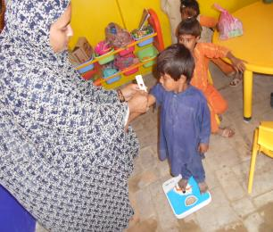
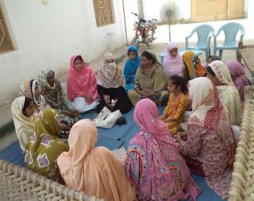
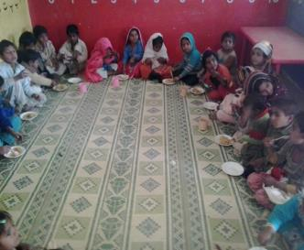
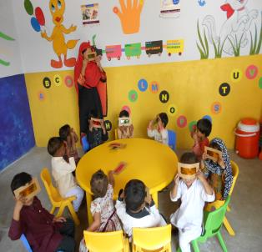
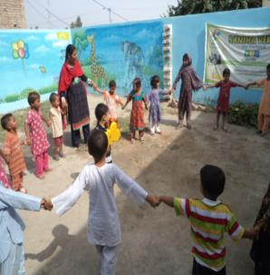
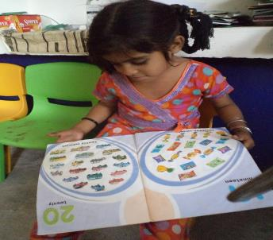
Sanjah/Panjho Vehra : Multiple Facets of ECD

Slide 17
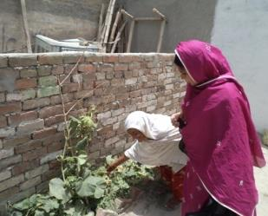
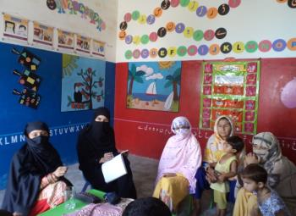
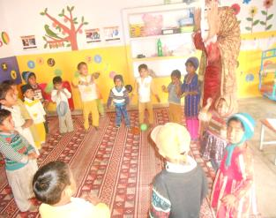

Female Support Groups for empowerment and decision-making
Activities undertaken by “SANJH “ Mothers’ Committee
Mothers engaged in: farming, sowing, harvesting, cattle farming; brick kilns handicrafts, stitching & now beauticians !
Kitchen Gardening
Regular Meetings
Assisting teachers
Planning & Management

Slide 18
Beneficiaries of ECD Program
Jan 2012 to Feb. 2013
Target 3000 children to be achieved by June 2013.
District | No. of Centers | No. of Enrolled Children | % Girls | Mainstreamed Children
Kot Adu -Muzaffer Garh | 8 (one on self sustainable basis) | 1000 | 60 | 65
Zahirpir- Rahim Yar Khan | 4 | 550 | 60 | 30
Shikarpur | 4 | 450 | 50 | 10
Total | 16 | 2000 | 57% (average) | 105
Working Mothers | 1200 | Target 1500
Mothers/Siblings TVET | 60 | Target 300
Notes:
Global Context
Post MDGs and Rio + 20
Equity: Purposively focus and reach the most disadvantaged populations
Focus:
Better conceptualization
Understanding synergies and fine-tuning interventions
More investment
Strategies for UNICEF:
Generate new evidence through research and evaluation initiatives more equitable and research-based
Capacity building of UNICEF staff and counterparts to reaching the marginalized and the disadvantaged, costing, and supporting policy implementation at the national and subnational levels.
Continued increased and strengthened partnership for ECD

Slide 19
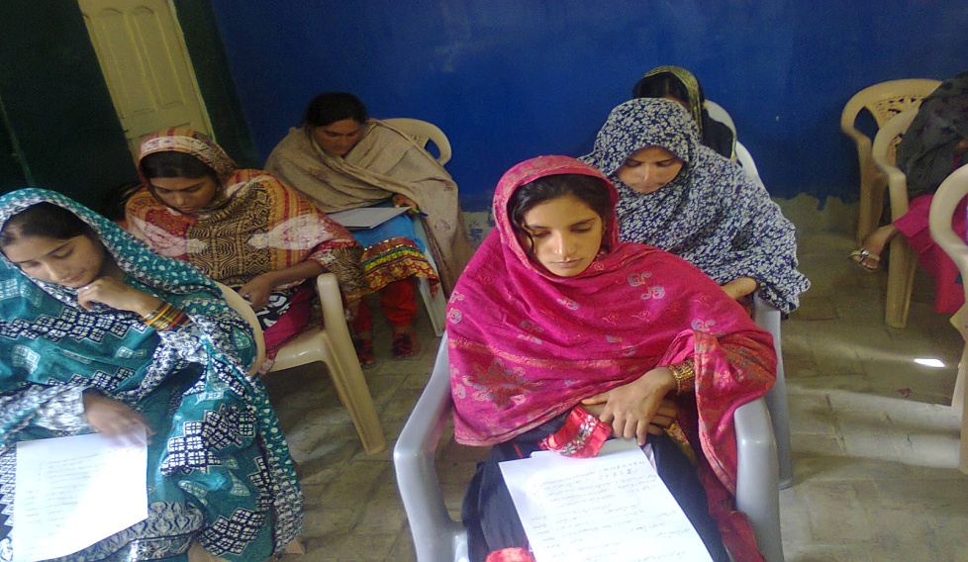
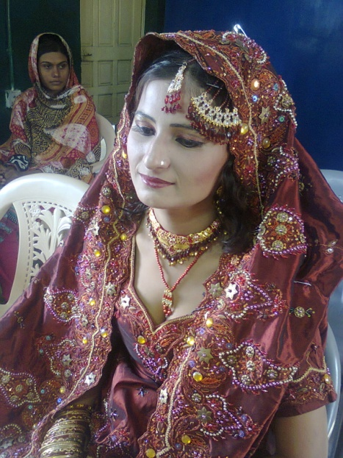
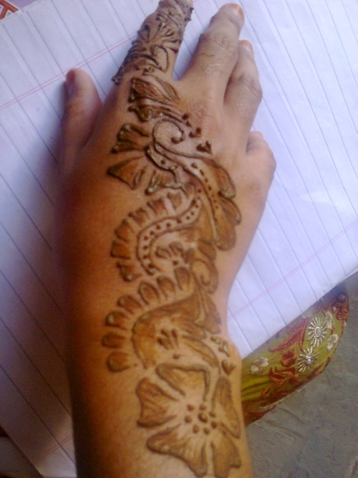
Vocational Training Course for Mothers
3 months certified beauticians course for mothers/care givers of ECD centers and other trades/ stitching, (agriculture and livestock to begin)

Slide 20
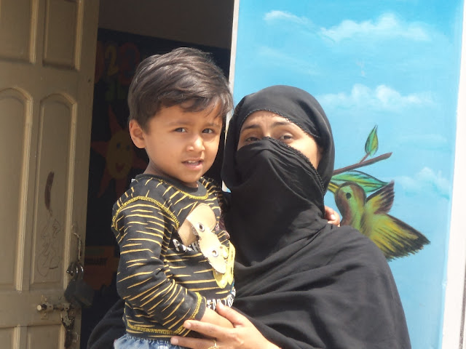
Working Mothers Benefiting the program
“The SVs are a special gift for women like me in rural areas who cannot afford much but desire to improve themselves and their family.”
Shabana - a mother

Slide 21
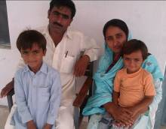
Transforming lives ……through SV/PV
“It could happen just because of the teachers who gave love and confidence to my child” said the parents of Sikander; a young child with many negative experiences of learning & schooling

Slide 22
Assessment, Tracking & Research : enrolled, mainstreamed for capturing transitions
Use and finalization of common sense systematic Monitoring tools – for all dimensions being refined: ARNEC; WB- SABER– Aga Khan University– Human Development Prog. Health Depts/LHWs
Regular assessment of different developmental domains Learning Metrics Taskforce (LMTF)’s 5 domains: physical well-being, social and emotional, literacy and communication, learning approaches and cognition, and numeracy and mathematics: within local contexts
ICP ( Individual ECD Profile) pre tested and being implemented since Feb 2013 – an individualized portfolio with milestones
Meetings across ECD Centres & schools where children are being mainstreamed for a simple agreed tracking tool
An ambitious longitudinal study for this program is being initiated in April 2013 to track pre primary to post primary transitions for policy influence- looking at other studies such as CECED /ASER India- others with inputs from ARNEC - INEE

Slide 23
Challenges & Opportunities
Inclusive approaches to ensure challenged children get timely support; early detection/ referrals.
Institutional ownership of the program health, education or/and social welfare ?
Mobilizing resources to meet demand for SVs from nearby villages& districts
Reporting progress on indicators for MDGs/EFA ..to key decision makers/bodies
Rigorous long term research collaborations for policy influence
Linkages with Special Education depts. and specialists- an emergent area
Creating ownership of the program across 2-3 depts. Leading to National ECD policy
1. Provincial govts. advocating for results, costs/ impact resources
2. South Asia /SAARC level
3. New Donors – Foundations
4. Making ECD centres sustainable as social enterprises -
Working w. research groups in the region to influence national, regional and global goals

Slide 24
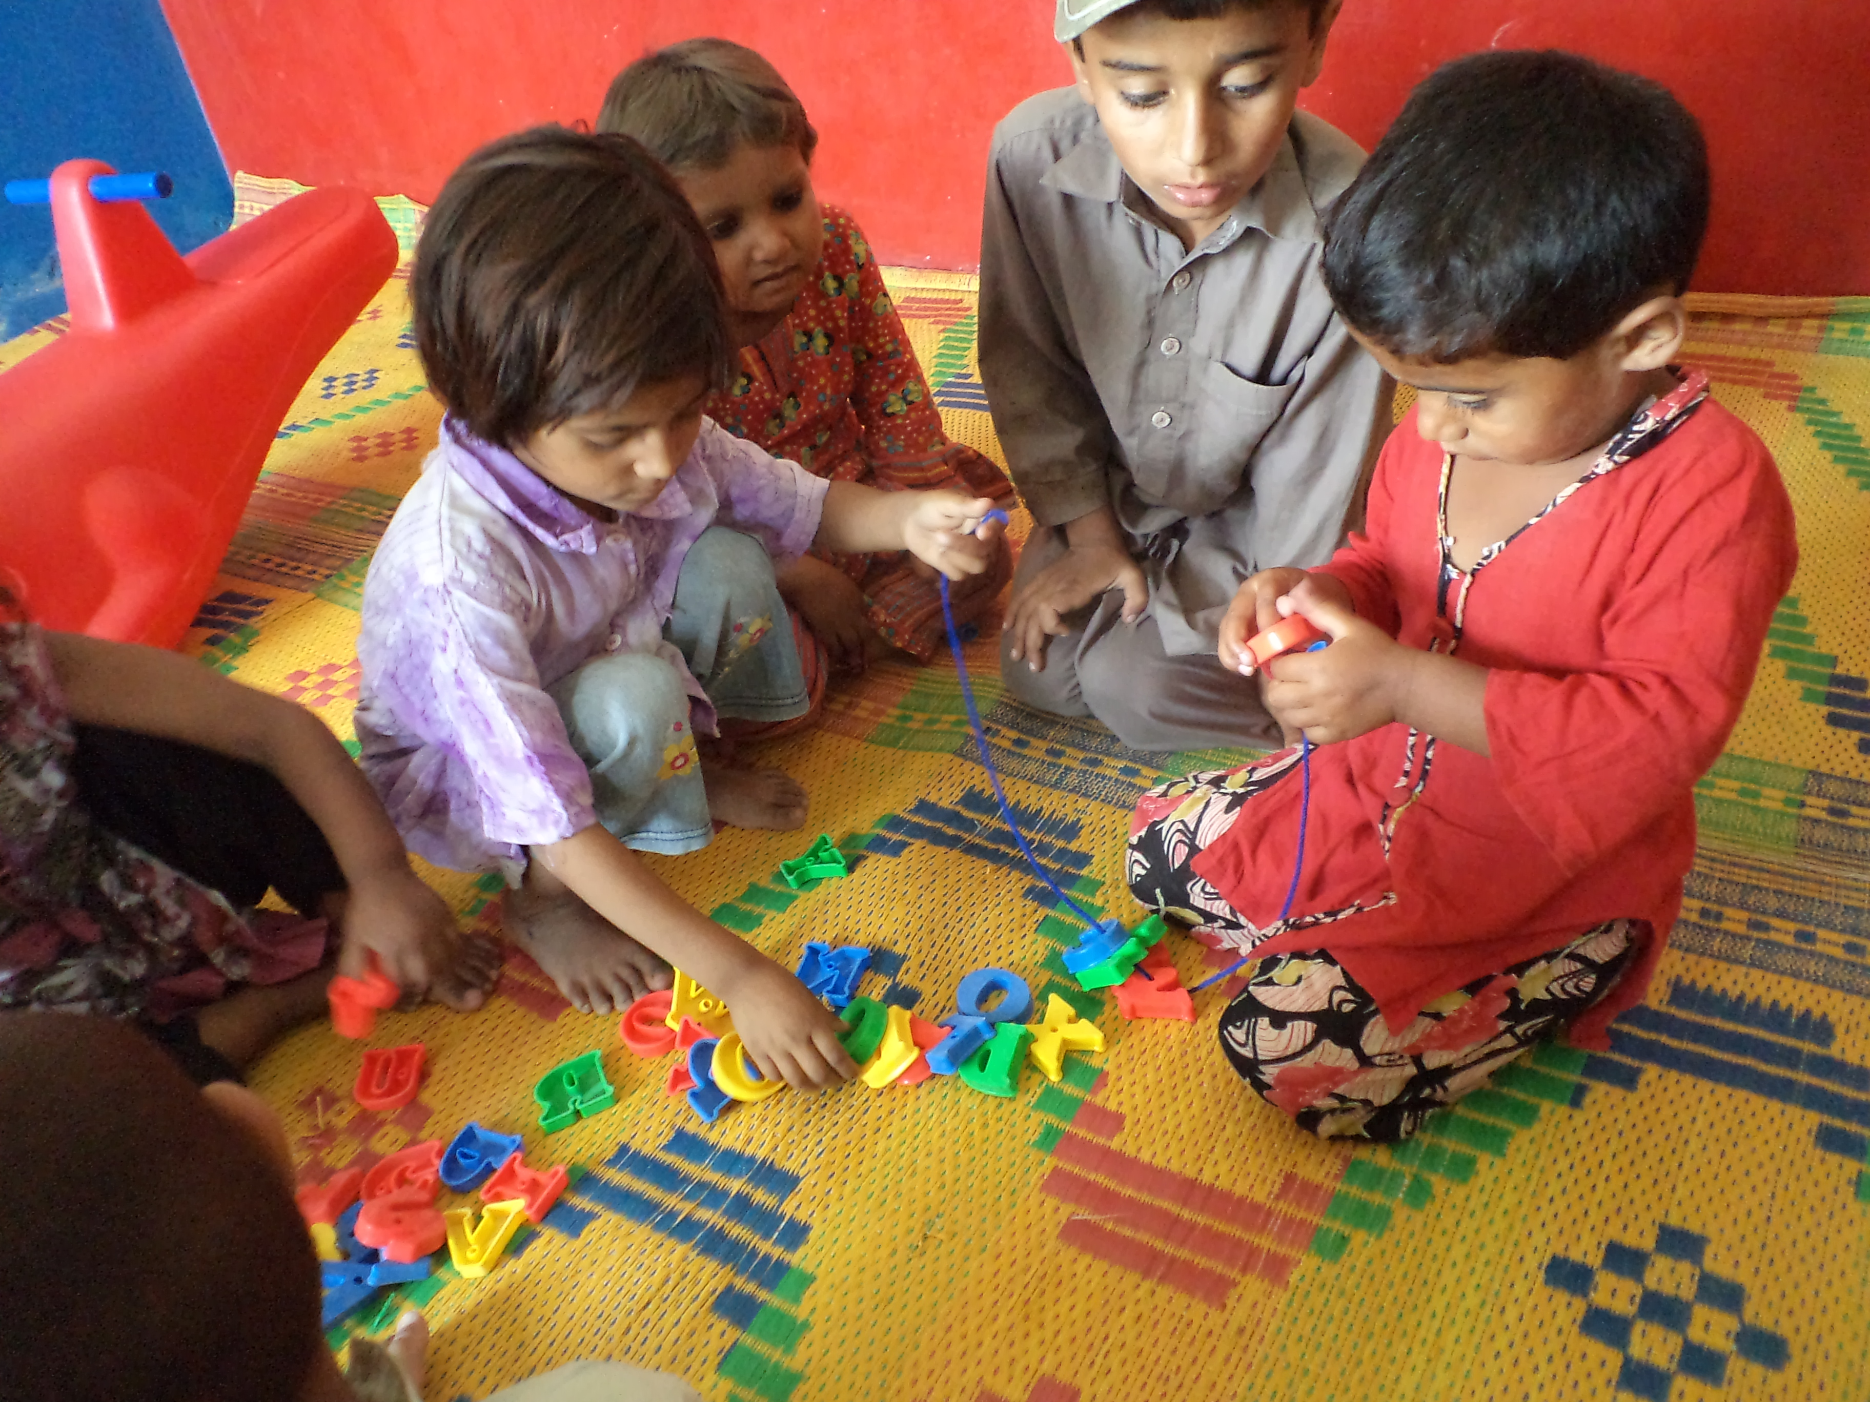
Thank You
For all info : email: itacec@gmail.com and sanjhavehraita@gmail.com

